Slide 1
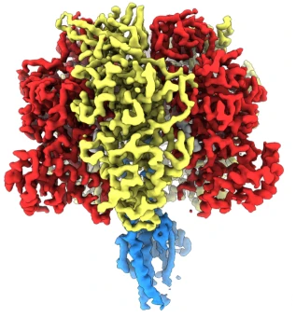
Resolution of distinct rotational substeps by submillisecond kinetic analysis of F1-ATPase
Aldric Mercier, Emile Chauvel, Ami De Carli, Théo Rousset
Cryo-EM maps of Bacillus PS3 F₁-ATPase in two rotational dwells, Sobti, Nature communications, 2021
Main reference:
Yasuda, R.; Noji, H.; Yoshida, M.; Kinosita, K.; Itoh, H. Resolution of Distinct Rotational Substeps by Submillisecond Kinetic Analysis of F1-ATPase. Nature 2001, 410 (6831), 898–904. https://doi.org/10.1038/35073513.
Notes:
Intro,
Read title
Resolution of distinct rotational substeps by submillisecond kinetic analysis of F1-ATPase

Slide 2
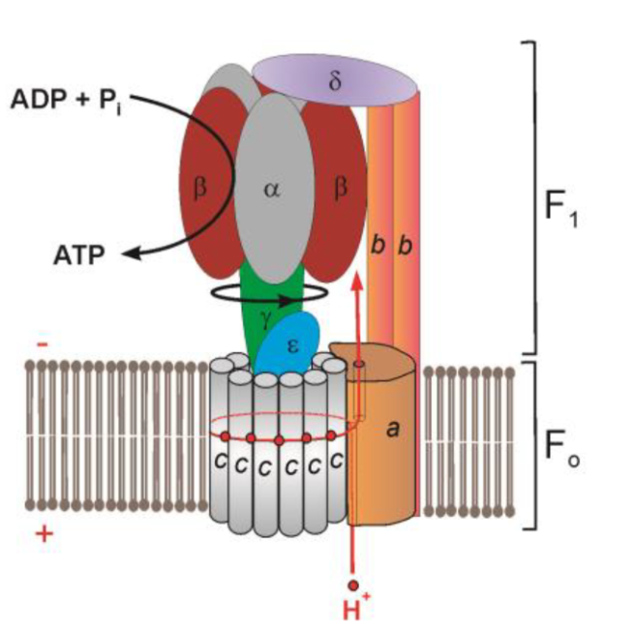
ATP synthase
In prokaryotic cells, lies across plasma membrane
In eukaryotic cells, lies across inner mitochondrial membrane
Made of water a soluble and an insoluble part
Uses proton flow to catalyze ATP synthesis from ADP
Fo, rotates due to proton binding/flow
F1, synthesizes ATP as shaft (gamma unit) rotates
Schematic illustration showing the arrangement of subunits in F₁·F_{o}-ATP synthase/ATPase (E. coli), Zharova, International Journal of Molecular Sciences, 2023
Notes:
ATP synthase is molecular rotor, a protein, an enzyme
lies across plasma membrane (prokaryotic) or lies across inner mitochondrial membrane (eukaryotic)
-ATPase (ATP synthase), made from Fo (water insoluble, in membrane) and F1 (water soluble)
F1 motor, is beta alpha, delta, gamma eppsilon
Fo motor is the rest, spins due to proton binding to c subunit/proton flow
→proton goes through half channel, binds to c and goes out after full c rotation.
→ energy transfered by shaft (gamma) to F1 motor
-As shaft rotates, conformational changes occure in catalytic subunits
-would synthethise ATP using proton flow through Fo( transmembrane part) due to pH differential and electrical membrane potential proton electrochem gradient flow
-proton flow from high concentration to low concentration
-ATP hydrolysis (F1 part, in vitro, but pumps protons this time)/synthesis, both functions possible.
Structure of F1: alpha and beta cylinder with gamma unit inside
Made from subunits:
Alpha: can bind ATP but no cat. activity
Beta: binding and hydrolysis of ATP through hydrogen bonding and electrostatic interactions, ATP/ADP are at quilibrium on beta site
Gamma: rotor, spins as binding and hydrolyzing take place

Slide 3
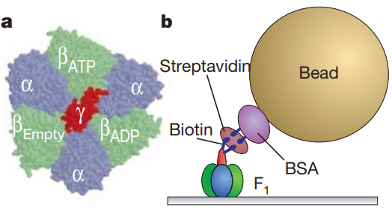
F1-ATPase
A type of F-ATPase
F1 is the water-soluble subunit of ATP synthase
In-vitro, it hydrolyzes ATP
The motor works from hydrolyzing ATP, more ATP causes a higher hydrolysis rate until saturation
Gamma subunit can be used to link actin filament, polystyrene beads and gold particles
Atomic structure of F1-ATPase viewed from the Fo side and side view of the observation system, Yasuda, Nature, 2001
Notes:
F-ATPase- a type of ATP synthase- found in bacterial plasma membrane, mitochondrial membranes,
Works usually as synthase- synthesis of ATP
-F1-part of the ATP synthase(water soluble part, a3b3gamma delta epsilon) → hydrolises ATP which rotates rotor
→more ATP = higher rotation rate until saturation
-Here, from Bacillus PS3 bacteria what is used in this study, but bound to surface
-Works just as explained before, but no Fo no proton flow
ON IMAGE:
Gold beat coated with biotinylated BSA (bovine serum albumine, protein Streptavidin to connect rotor to bead)
Different object bound to it for study its kinetic properties, gold or polystyrene bead, and actin filament

Slide 4
Prior to the study
Presence of three beta sub-units and a gamma subunit and the cylindrical structure
There is uncertainty about location of the catalytic sites
Role of alpha, beta, gamma subunits are different
The initial steps were believed to be 120 degrees, but the sub steps were not known nor was the associated mechanism
Schematic illustration showing the arrangement of subunits in F₁·F_{o}-ATP synthase/ATPase (E. coli), Zharova, International Journal of Molecular Sciences, 2023
Notes:
-Prior to study: know function and approximate structure of protein and that ATPase is a transmembrane protein
-Isolation of F1 and observation of gamma rotation during ATP hydrolysis
-Uncertainty about the catalytic sites of ATP synthesis
-Interaction with subtrate and roles of Alpha beta and gamma are different
-Researchers knew that ATP synthesis was coupled to proton flow through gamma linked to F1 but uknown sub-steps of rotor and assoaicated kinetics

Slide 5
Hypothesis
One molecule consumed per 120-degree steps due to protein structure
ATP hydrolysis on beta subunits would induce gamma rotation
A more intricate mechanism present a mM concentration
Faster rotation at mM concentration
Notes:
-research prior to study showing ATP hydrolysis equals 3 times rot. Rate, assumption this was due to hexameric structure
-Hypothesis that the ATP hydrolysis on beta subunits would induce gamma rotation (makes the motor run)
-Perhaps a different mechanism was present at mM concentration due to smooth motion at mM conc. or that faster rotation produced more friction→ causing resistance against rotation

Slide 6
The F1-ATPase used in this paper
Derived from thermophilic Bacillus PS3
Lower affinity than for other ATPases
Probably used because of lower activity allowing for high expression
Probably used because of slower rotation speed
Krah, A., & Bond, P. J. (2018). PeerJ

Slide 7
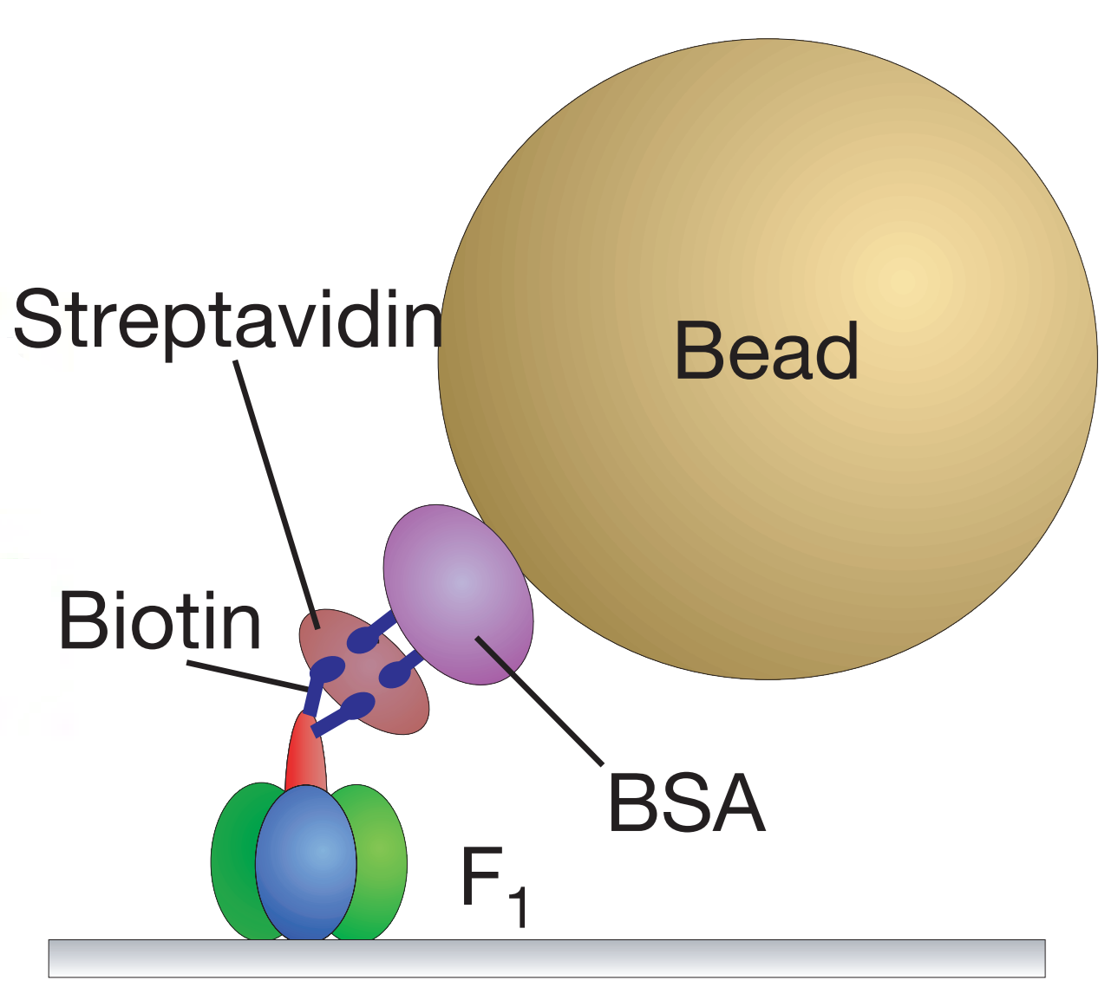
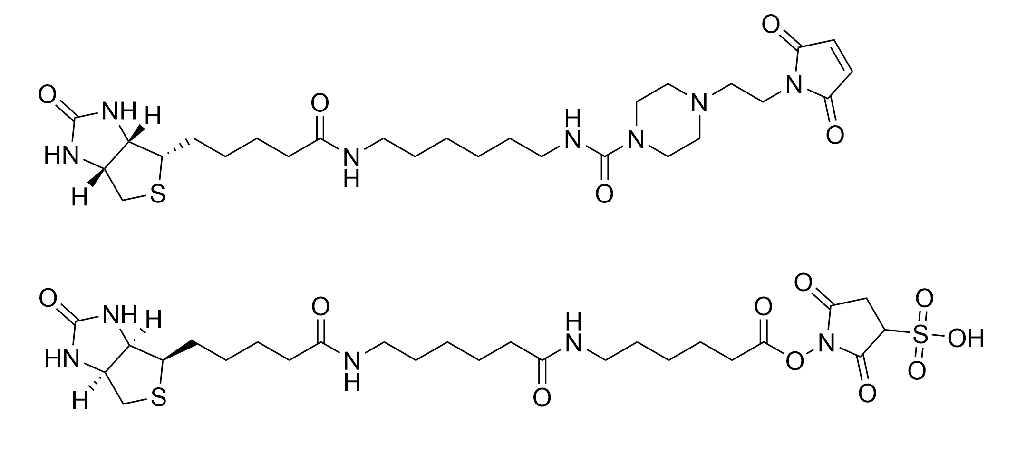
γ-subunit to bead assembly
Mutant γ shaft, with two cysteines for linkage with biotin
BSA on gold bead, with biotin
Both linked with Streptavidin (high affinity for biotin)

Slide 8
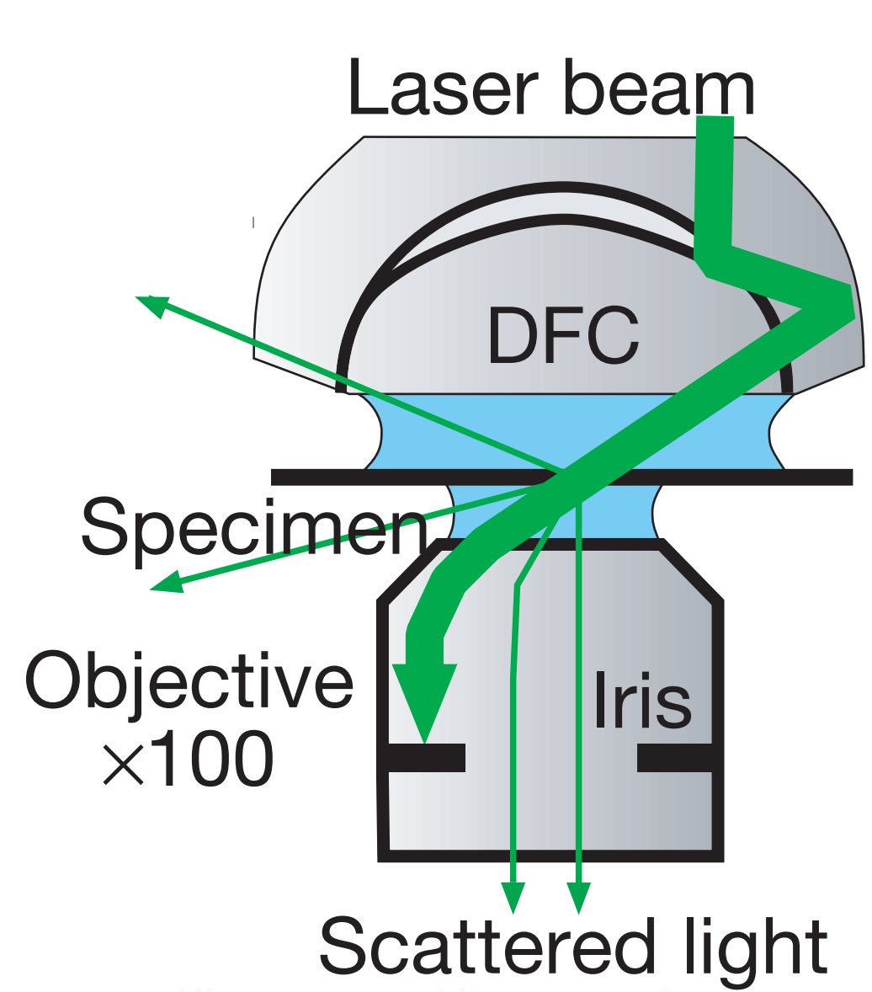
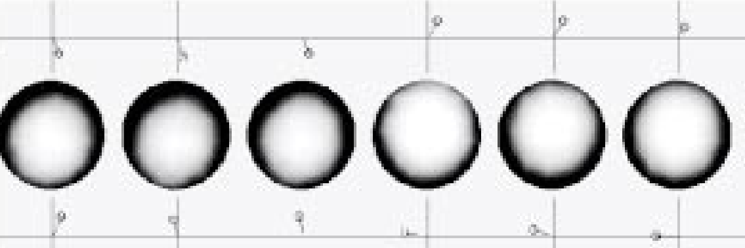
Observation of the rotation
Laser Dark Field Microscopy at 532 nm, measure scattered light
100-time magnification
Verify that they only measured single beads
Verify that the laser did not change dynamics

Slide 9

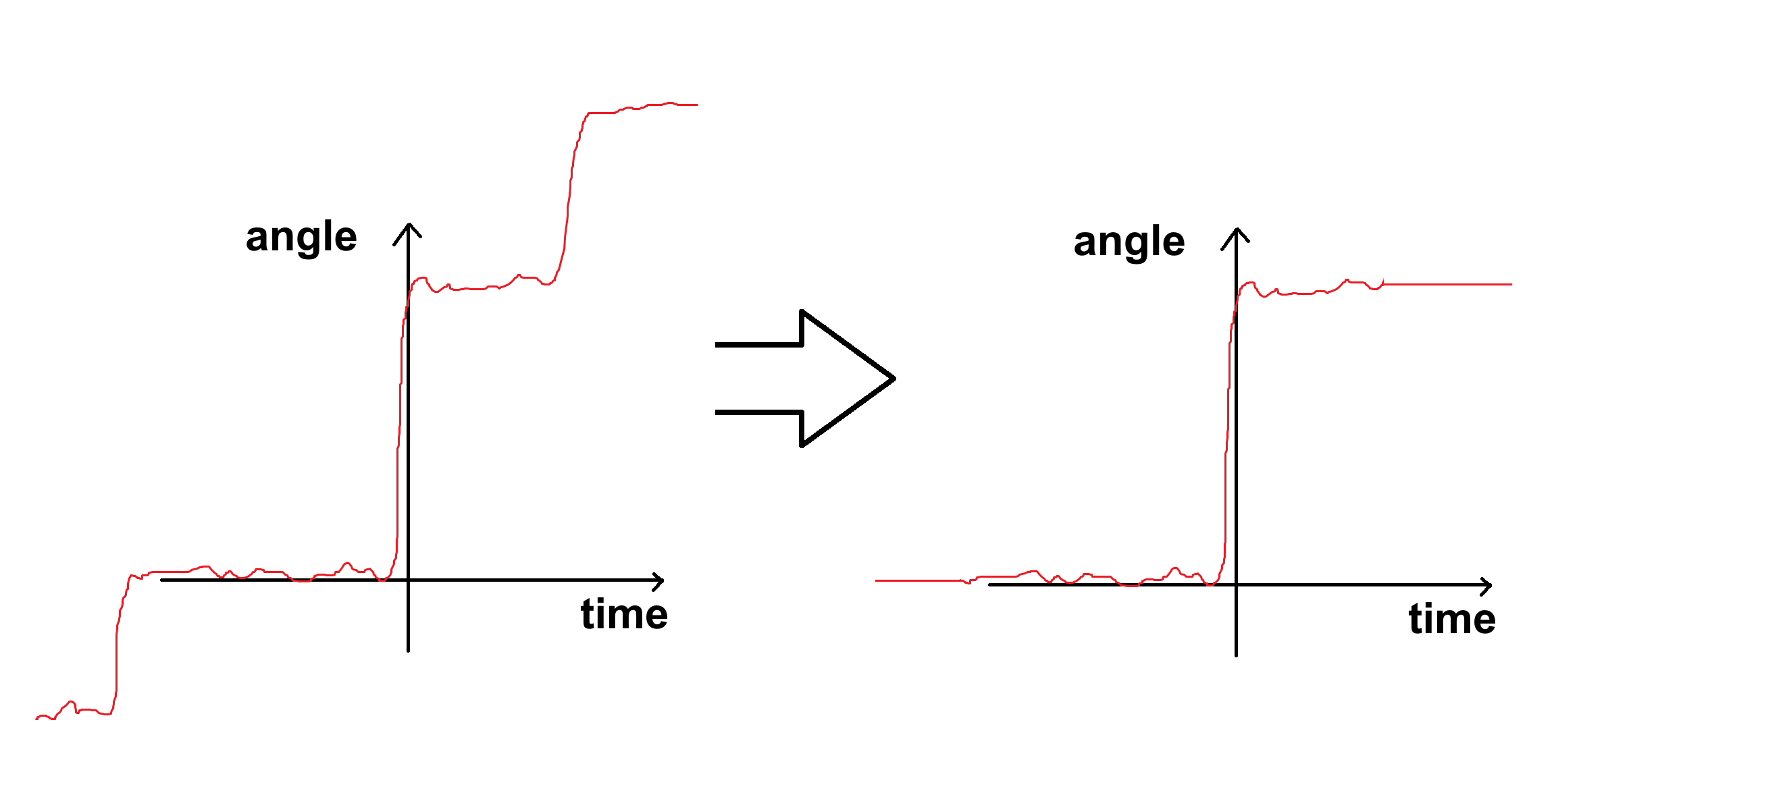
Observation and data extraction
Spot size = 300 nm, the diffraction limit size
Computed the centroid of the bead image, giving bead position
Steps were identified manually, other steps deleted. Data aligned and averaged

Slide 10
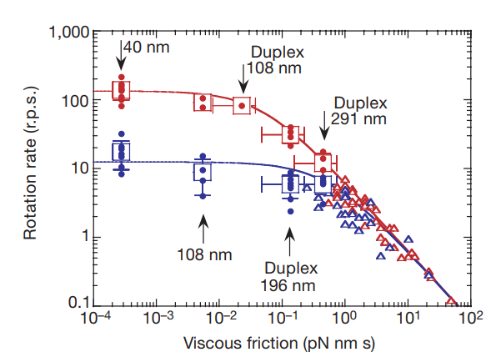
40-nm beads effect on rotation
Compared to actin filament
No speed reduction
Significant increase of viscous drag
Variable rotation diameter observed, 25-55 nm, indicates non-homogenous linkage of the beads
Figure 2. relation between viscous friction and rotation rate (red 2 mM, blue 2 μM ATP)

Slide 11
Stepwise mechanism
The stepwise mechanism is observed at high and low speeds
The stepwise mechanism does not depend on low speed or high drag, it is inherent of the system

Slide 12
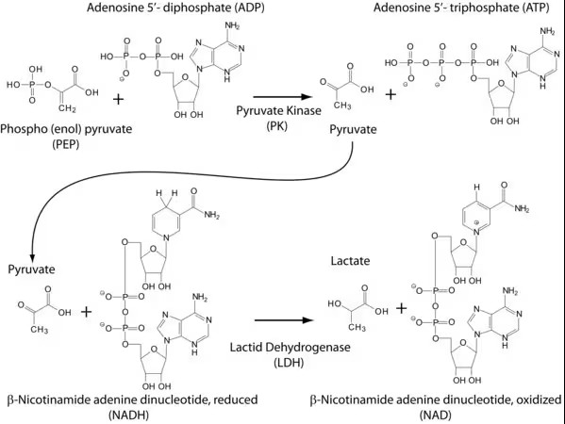
ATP hydrolysis rate measurement
Regenerate ATP with phosphoenolpyruvate using Pyruvate kinase
Transform pyruvate in lactate with NADH using Lactate dehydrogenase
Measure NADH depletion at 340 nm

Slide 13
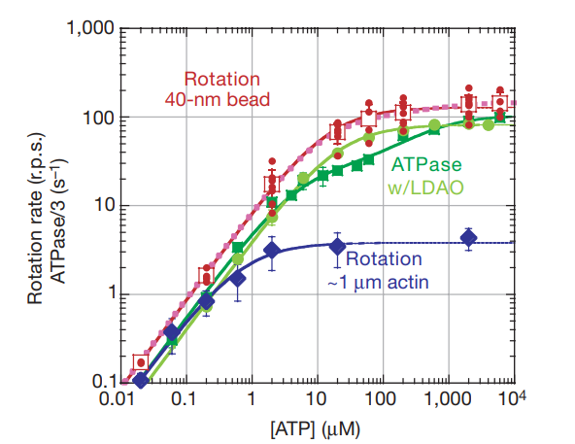
One rotary mechanism
Michaelis-Menten dependance on ATP concentration
Vmax = 129 r.p.s
KM = 15 μM
Single mechanism regardless of rotation speed
Figure 3. comparison of hydrolysis and rotation rates. (blue and red curves are in presecnce of LDAO)

Slide 14
Matching results and assumptions
k_{on} of 2.6·10⁷ M⁻¹ s⁻¹ was observed
1 ATP molecule was hydrolyzed per 120° step
⇒ matches with previous results
Hydrolysis rate was lower around 50 μM, assumed it was due to MgADP inhibition
Double Michaelis-Menten explored but did not improve the fit over simple MM

Slide 15
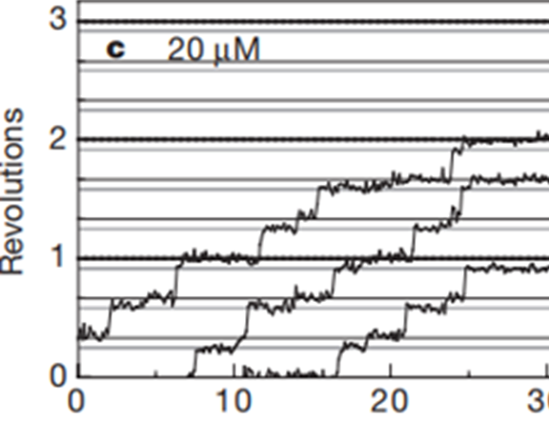
Two substeps
At high time resolution, two substeps are observed:
Fast ~ 90° substep, followed by a short dwell
Second ~ 30° substep
The first substep is ATP dependent, the second one isn’t
Substeps are more visible at lower concentrations
Figure 4c. Unfiltered time course of stepping rotation of 40 nm beads ([ATP] = 20 μM)

Slide 16
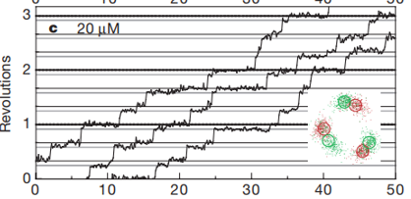
Unfiltered time courses
Thick black lines numbered 1, 2 and 3 represent full 360° rotations
Thinner black lines represent the 120 ° steps
Gray lines represent 90 ° steps
Figure 4c. Unfiltered time course of stepping rotation of 40 nm beads ([ATP] =20 μM)

Slide 17
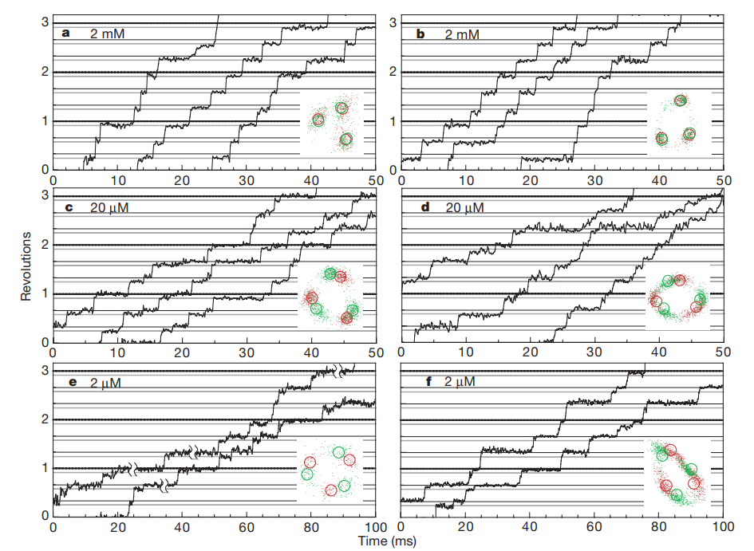
Figure 4a-f. Unfiltered time course of stepping rotation of 40 nm beads ([ATP] varies)

Slide 18
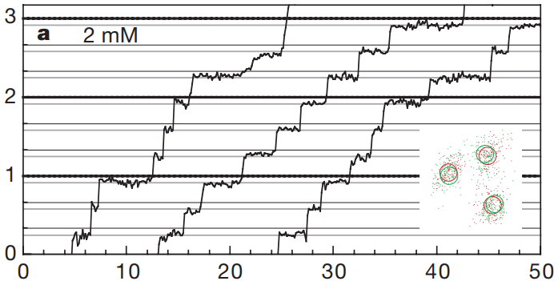
Let’s zoom in, 2mM
Figure 4a. Unfiltered time course of stepping rotation of 40 nm beads ([ATP] =2 mM)

Slide 19
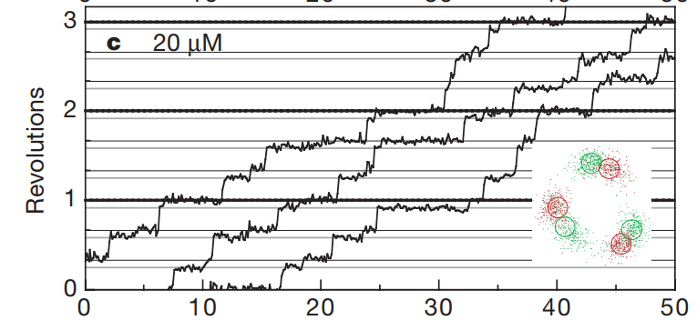
Let’s zoom in, 20μM
Figure 4c. Unfiltered time course of stepping rotation of 40 nm beads ([ATP] =20 μM)

Slide 20
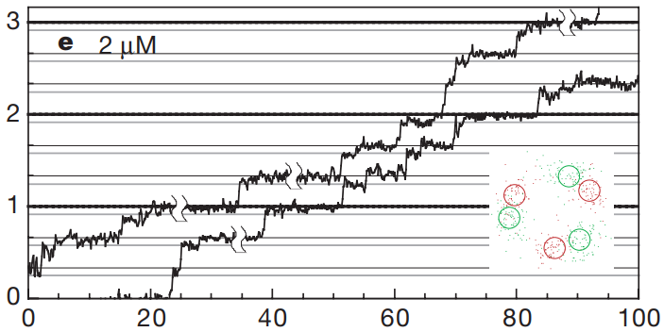
Let’s zoom in, 2μM
Figure 4e. Unfiltered time course of stepping rotation of 40 nm beads ([ATP] =2 μM)

Slide 21
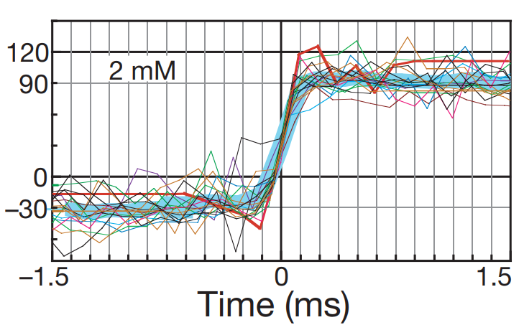
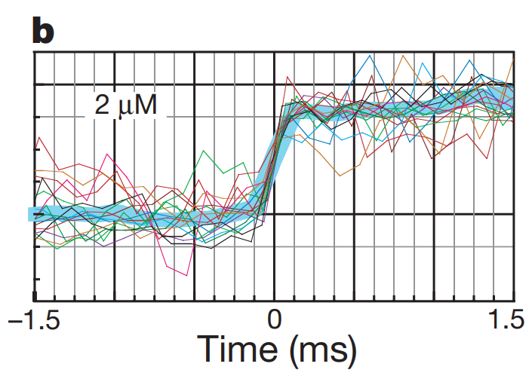
Kinetics of the substeps
Get multiple measurement for each concentration
Average (large cyan line)
Transitions are fast (up to 0.25 ms → 2 frames)
Speed of rotation part not affected by [ATP]
Dwell are different
Figure 6 a and b. Plots of displacement of gold particles as a function of the time and its average (cyan)

Slide 22
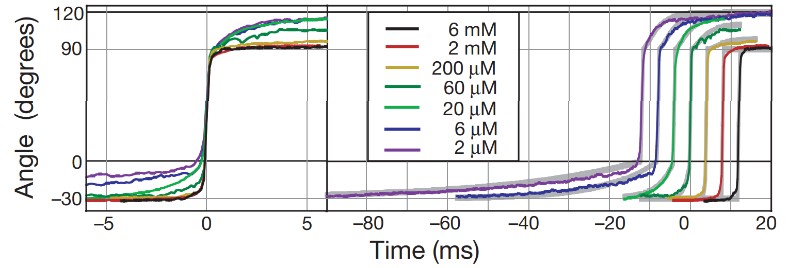
Kinetics of the substeps
Average at all concentrations
Best fit gives a 90° substep (30° hard to judge)
Removed unusable data and flattened the ends for high concentrations
Figure 6c. Average displacement of gold particles at each [ATP] as a function of the time

Slide 23
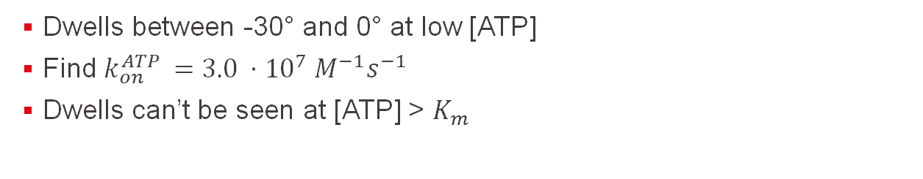
Kinetics of the substeps
Dwells between -30° and 0° at low [ATP]
Find $k_{on}^{ATP }=3.0 ⋅{10}^{7} M^{−1}s^{−1}$
Dwells can’t be seen at [ATP] > $K_{m}$
Figure 6c. Average displacement of gold particles at each [ATP] as a function of the time

Slide 24
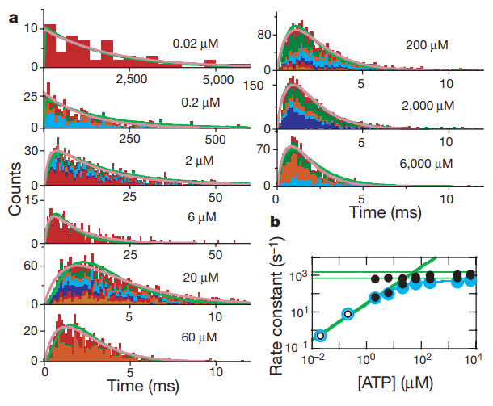
Kinetics of the substeps
Hundreds or thousands of measurements
Study Dwells length
Exponential fits to get the constants
Quick step must be a two-step process
Find rate-limiting reactions
Figure 8 a and b. Exponential fit of Dwell durations and plot of the associated rate constants as a function of [ATP], best exponential fit (purple) and theoretical exponential (green)

Slide 25
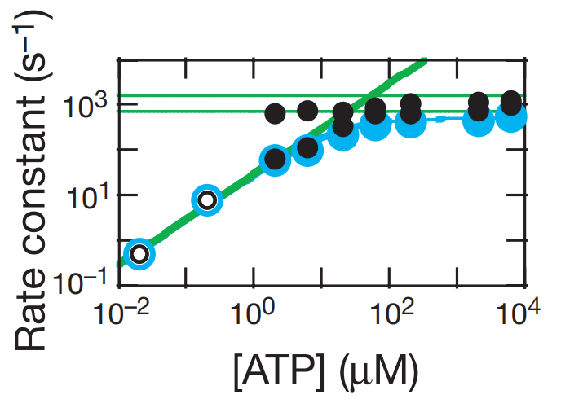
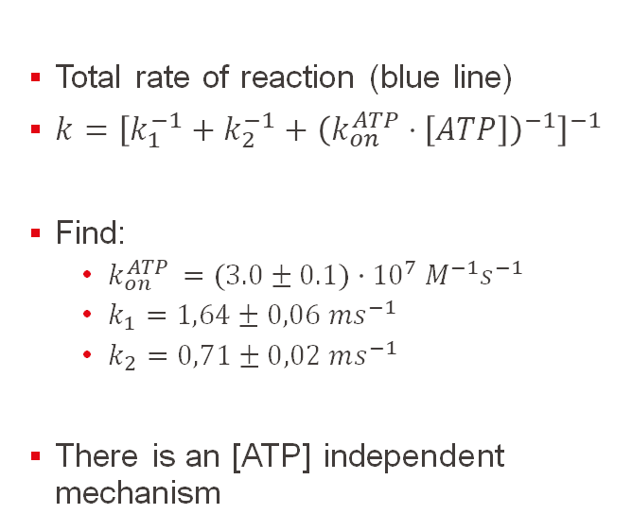
Kinetics of the substeps
Total rate of reaction (blue line)
$k={\left[k_{1}^{−1}+k_{2}^{−1}+{\left(k_{on}^{ATP}⋅\left[ATP\right]\right)}^{−1}\right]}^{−1}$
Find:
$k_{on}^{ATP }=(3.0±0.1)⋅{10}^{7} M^{−1}s^{−1}$
$k_{1}=1,64±0,06 ms^{−1}$
$k_{2}=0,71±0,02 ms^{−1}$
There is an [ATP] independent mechanism
Figure 8b. Plot of the rate constants of each experiment as a function of [ATP].

Slide 26
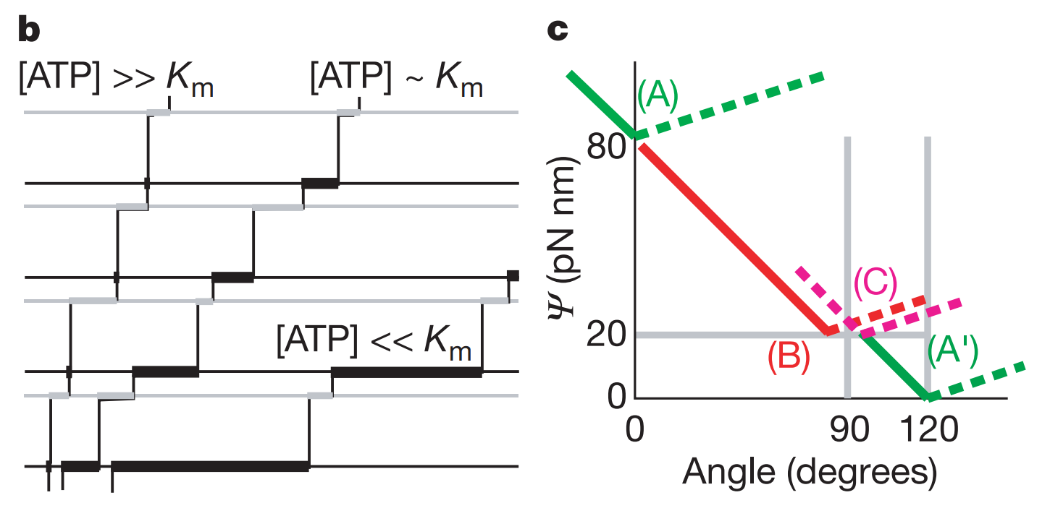
Proposed detailed mechanism
B:
Simplified profile showed earlier
See at different [ATP] what governs the speed of reaction
C:
Lowest energy at A
ATP binds new lowest energy
Continues until A’
Figure 7b and c. Stepping course that one would expect from 7a, Schematic representation of the potential energy evolution of γ-subunit during the rotation

Slide 27
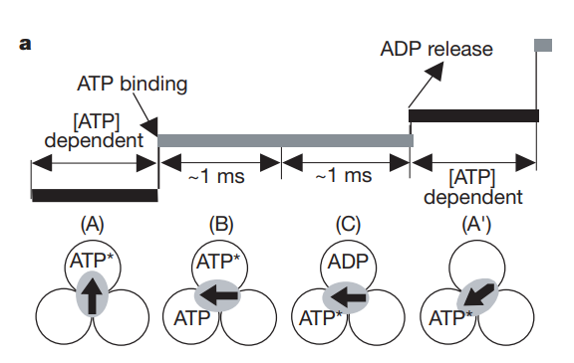
Proposed detailed mechanism
[ATP]-dependant dwell
Two ~1 ms processes
Mechanism:
1. ATP binding
2. hydrolysis
3. ADP (and phosphate) leaves
We are back to 1.
Is consistent with literature
Figure 7a. Detailed mechanism of the rotation of the protein. The two sub-steps are: 1) ATP hydrolysis and 2) ADP release

Slide 28
Conclusions
Viscosity is not significant for beads bellow 196 nm diameter
The maximum speed reached was 129 r.p.s, the Michaelis Menten parameter was 15 μM. A single mechanism at all speed: one ATP molecule consumed per 120° step.
Fast 90° substep, caused by ATP binding, ATP dependant, followed by ATP-independent dwell
Second 30° substep, liberation of ADP. Energy mainly from ATP binding, not hydrolysis

Slide 29
Outlooks
Explore reverse reaction: for ATP synthesis instead of hydrolysis
Find if the complete generator can work in the motor configuration in living organisms
If so, is the motor in high viscosity (high torque) regime in living organisms ?
Explore non-thermophilic ATPase at physiological temperature

Slide 30
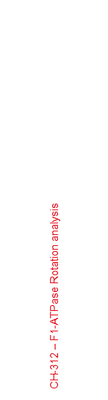
Questions
What other viable high-resolution methods could have been used to study the kinetics of F1-ATPase?
Notes:
Size of rotor, 20 nm by 10 nm,
Rotation diameter of 22nm – 55 nm
Main answer, time resolved fluorescence imaging, single molecule excitation
allows microsecond imaging res.
Spatial resolution- 10-30 nm, almost too large, but possible
Much smaller than the bead, less friction/drag
Not NMR, molecule is too big, slows molecular tumbling and low quality signal due to line broadening and fast relaxation
TR-FRET attached to one of the alpha parts, difficult to select one per rotor but resolution is high enough, 1 to 10 nm
Temporal resolution of around 10 to 100 micro s, SUFFICIENT??
Simulations? Running simulations of the system to compliment experimental data
https://www.bmglabtech.com/en/time-resolved-fluorescence/

Slide 31
Questions
Why is studying such protein kinetics in detail important towards the advancement of scientific research?
Notes:
ATP binding may be the principal source of these molecular rotors→ knowing kintetics means knowing how they function
Several different proteins function with ATP such as Myosin
→protein family responsible for muscle contraction and in actin-based mobility
→converts chemical energy into mechanical energy
→ATP and hydrolysis product also near equilibrium
Lots of proteins’ functioning could be understood with such studies

Slide 32
Questions
The two mechanically silent steps have been assumed to be either, the release of ADP followed by release of other product, or the first being hydrolysis followed by release of both products. What techniques could be used to further investigate these steps?
Notes:
Phosphate Release Detection Using MDCC-PBP
It’s a fluorescent probe→can help mesure inorganic phosphate release
Has millisecond temporal resolution
Has been used in literature
HOW IT WORKS:
PBP: bacterial prot. Binds to phosphate with high affinity, conformation change while binding→ open (unbound) to closed (bound)
PBP has cysteine labelled with MDCC (a flurophore)
MDCC is very sensitive to conformational changes of PBP
Upon binding, 5 fold fluorescence increase
Allows to see when the inorganic phosphate is released during the two mechanicly silent substeps

Slide 33
References
(1)
Yasuda, R.; Noji, H.; Yoshida, M.; Kinosita, K.; Itoh, H. Resolution of Distinct Rotational Substeps by Submillisecond Kinetic Analysis of F1-ATPase. Nature 2001, 410 (6831), 898–904. https://doi.org/10.1038/35073513.
(2)
Jonckheere, A. I.; Smeitink, J. A. M.; Rodenburg, R. J. T. Mitochondrial ATP Synthase: Architecture, Function and Pathology. Journal of Inherited Metabolic Disease 2011, 35 (2), 211–225. https://doi.org/10.1007/s10545-011-9382-9.
(3)
Zharova, T. V.; Grivennikova, V. G.; Borisov, V. B. F1·Fo ATP Synthase/ATPase: Contemporary View on Unidirectional Catalysis. International Journal of Molecular Sciences 2023, 24 (6), 5417. https://doi.org/10.3390/ijms24065417.
(4)
Dennis, D. T. Mechanisms of Energy Transduction. The Biochemistry of Energy Utilization in Plants 1987, 19–26. https://doi.org/10.1007/978-94-009-3121-3_3.
(5)
Boyer, P. D. The Binding Change Mechanism for ATP Synthase — Some Probabilities and Possibilities. Biochimica et Biophysica Acta (BBA) - Bioenergetics 1993, 1140 (3), 215–250. https://doi.org/10.1016/0005-2728(93)90063-l.
(6)
Time-Resolved Fluorescence Measurements | BMG LABTECH. Bmglabtech.com. https://www.bmglabtech.com/en/time-resolved-fluorescence/ (accessed 2025-05-14).
(7)
TR-FRET Measurements | BMG LABTECH. Bmglabtech.com. https://www.bmglabtech.com/en/tr-fret/#:~:text=Time%2DResolved%20FRET%20(TR%2D,for%20high%2Dthroughput%20drug%20screening. (accessed 2025-05-14).

